Slide 1
Star-Galaxy Separation in Fornax
Sprint Day: Checking for RBG Contamination
Kayleigh Excell, Kabelo Tsiane, Yao-Yuan Mao, Arun Kannawadi
10 Sep 2025

Slide 2
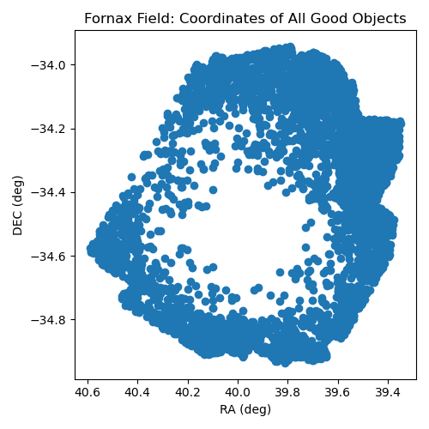
Created Fornax Field Star and Galaxy Catalogs
Queried DP1 data for objects within Fornax dSph field
Only objects where the deblend did not fail or skip, with SNR > 5
The hole is due to the failed deblending where there is high stellar density
Sorted stars and galaxies based on i_sizeExtendedness
For stars: < 0.5
For galaxies: > 0.5

Slide 3
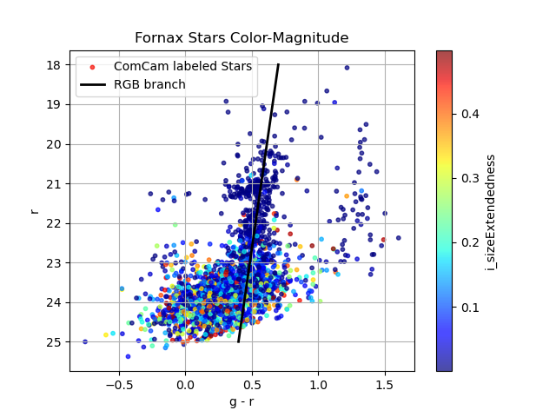
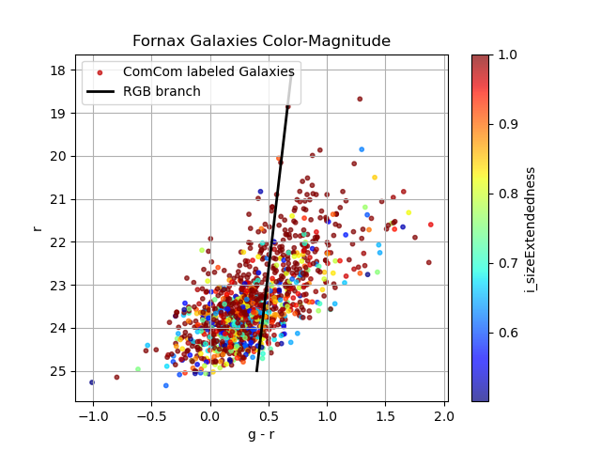
Color-Magnitude r vs g-r
Some minor signs of contamination of objects following the RGB branch in the galaxy catalog
Also tried using g_extendedness and r_extendedness as the S-G classification (stars = 0, galaxies = 1), not a huge difference

Slide 4
Next Steps
The next steps listed on Sprint Day were:
1) visually inspecting sources, 2) using Euclid star-galaxy sep to compare (see other set of slides), 3) improving how our pipelines sort
Analysis notebook: https://github.com/keexcell/star-gal_sep
Cleaning this up and documenting it
This analysis was done on USDF but can be recreated on NERSC or RSP (even just portal interface)

